Slide 1
Medians and Order Statistics

Slide 2
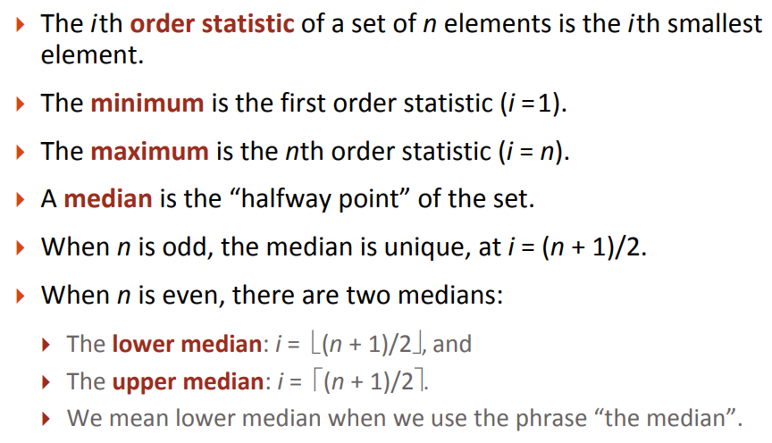
Order Statistics
If elements are sorted.

Slide 3
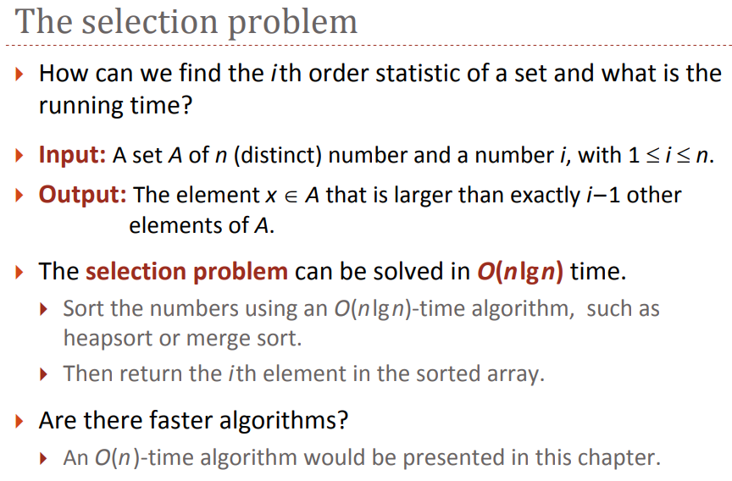

Slide 4
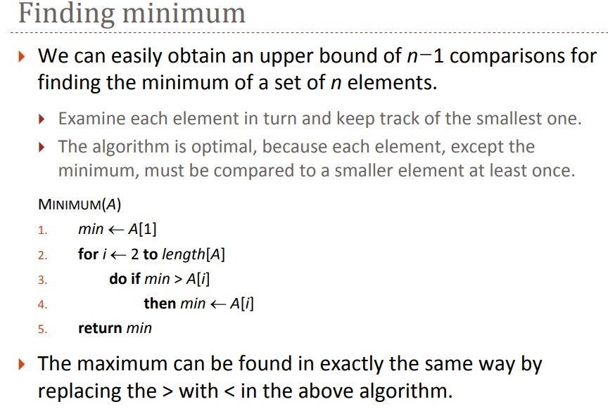

Slide 5
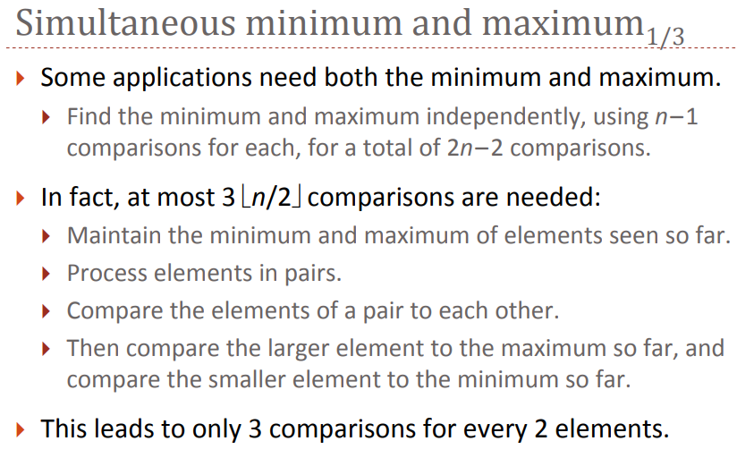

Slide 6
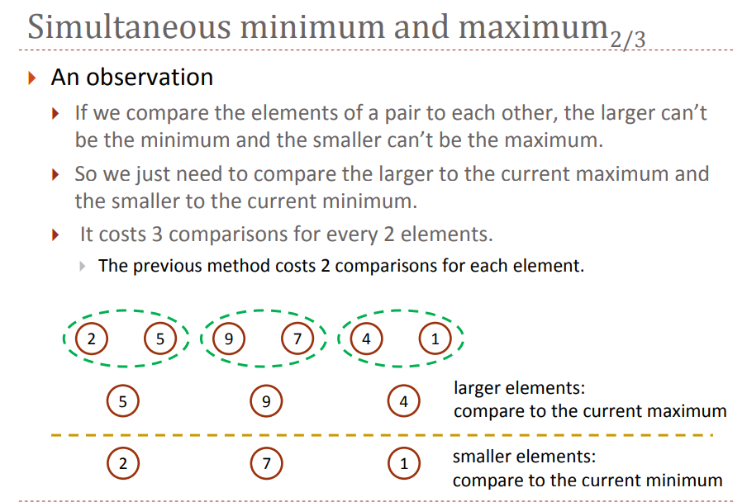

Slide 7
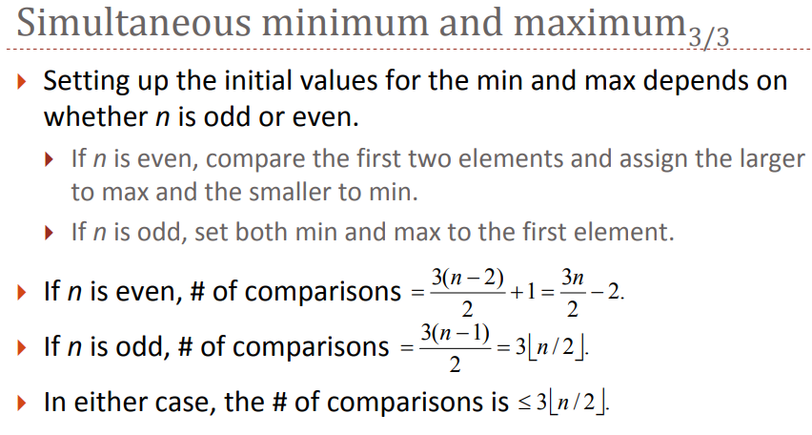

Slide 8
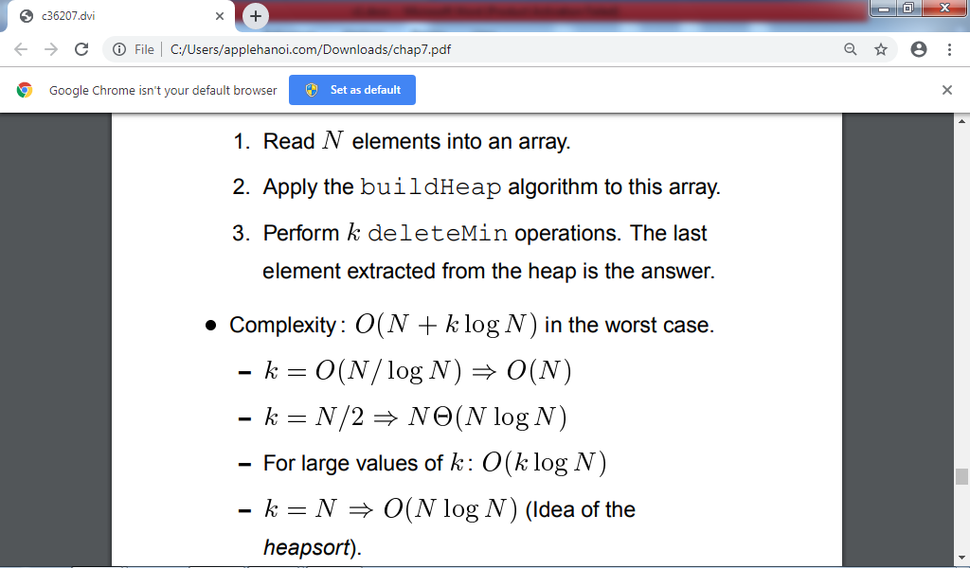
Select the k-th order statistics in O(nlgn) time using heap
Complexity of 3.

Slide 9
Selection in expected O(n) time using random quicksort
int partitionRand(int low,int up) { // return pivot index
int pivot,pivotval;
int i,j;
i = random(low, up);
swap(a,i,low);
pivotval=a[low];//Select a[low] as pivot value
i=low;
j=up;
while(i<j) {
while(a[i]<=pivotval && i<up) i++; //a[i]>pivotval
while(a[j]>pivotval) j--; //a[j]<=pivotval
if(i<j) swap(a,i,j);
};
swap(a,low,j); // put pivot value to pivot index place
pivot=j;
return(pivot);
}

Slide 10
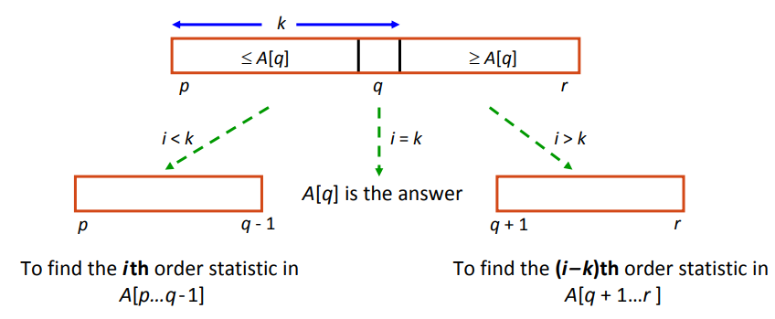
Random selection procedure - 1

Slide 11
Random selection procedure - 2
int orderSta_quick(int low,int up, int k)
{int pivot,i;
if(low==up) return(a[low]);
pivot=partitionRand(low,up);
if(pivot==k) return(a[k]);
if(k<pivot)
return(orderSta_quick(low,pivot-1,k));
else
return(orderSta_quick(pivot,up,k));
}

Slide 12
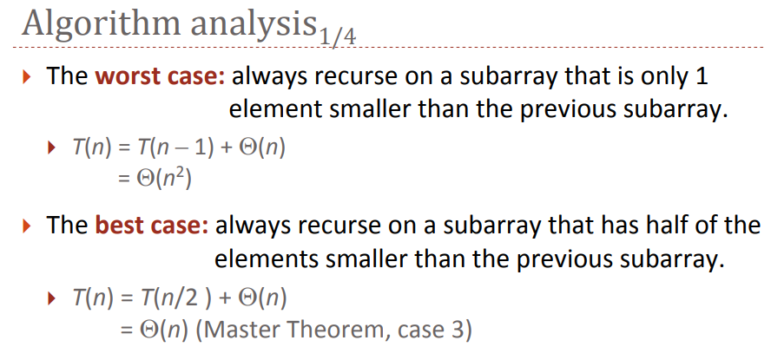

Slide 13
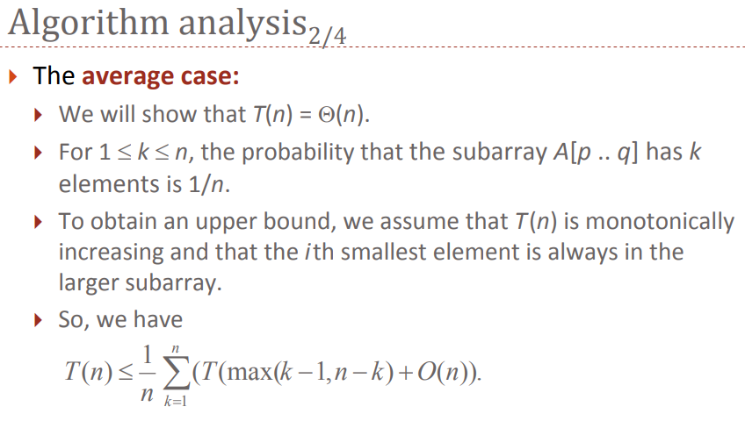

Slide 14
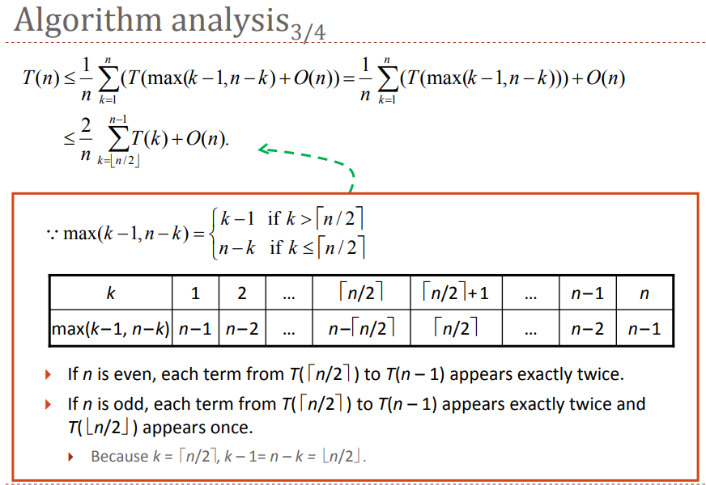

Slide 15
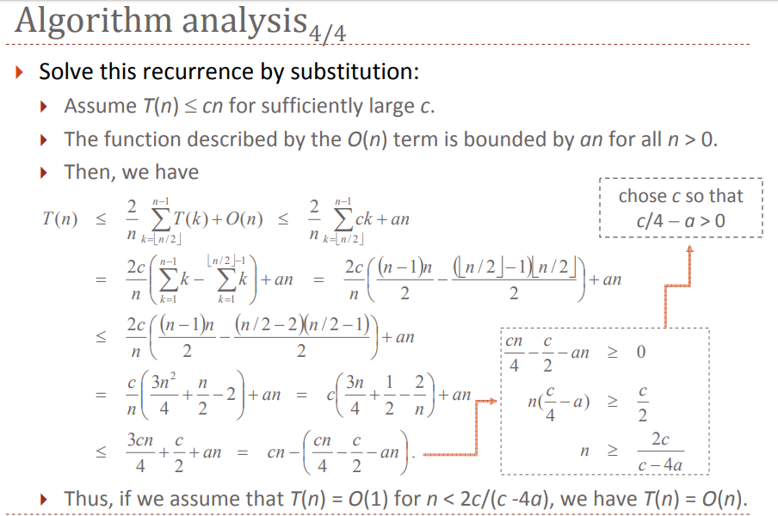

Slide 16
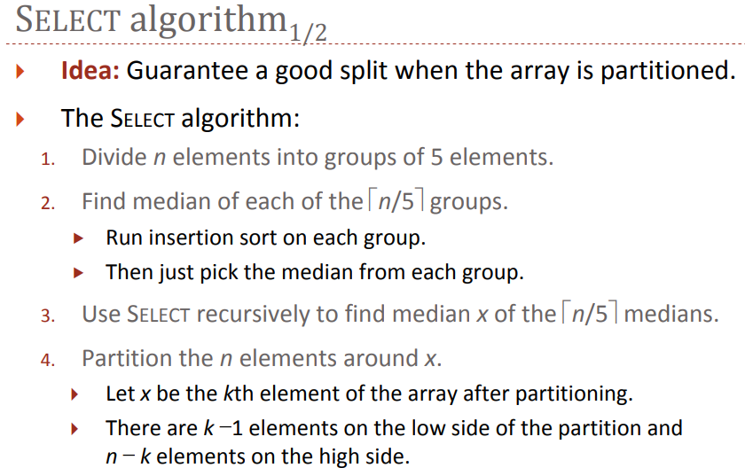
Select the i-th order statistics in O(n) time

Slide 17
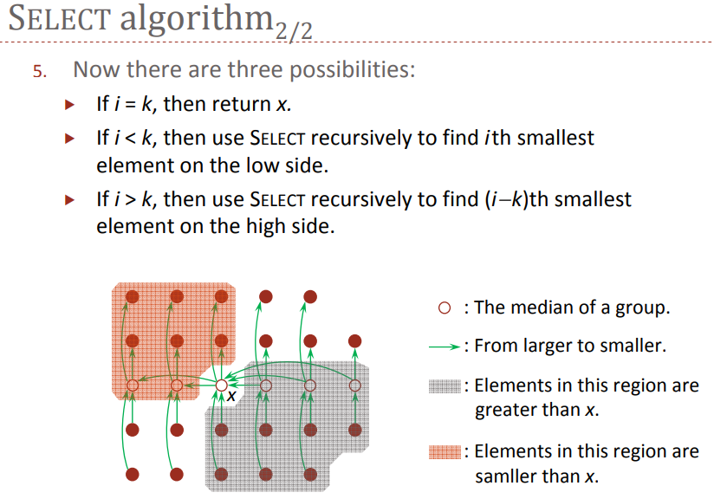

Slide 18
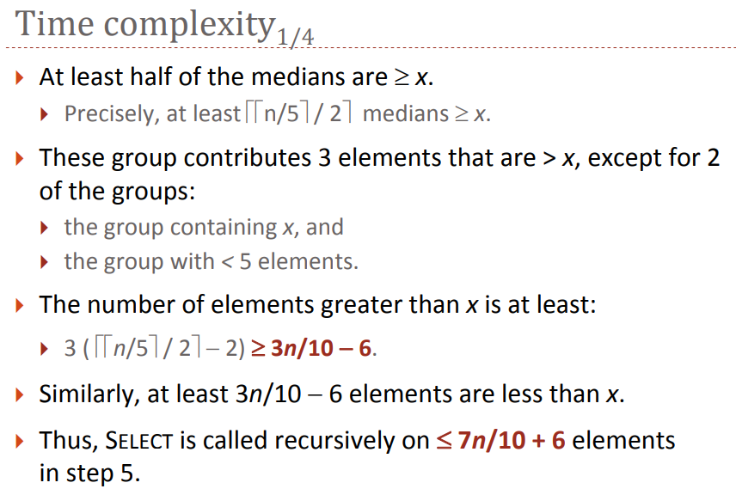

Slide 19
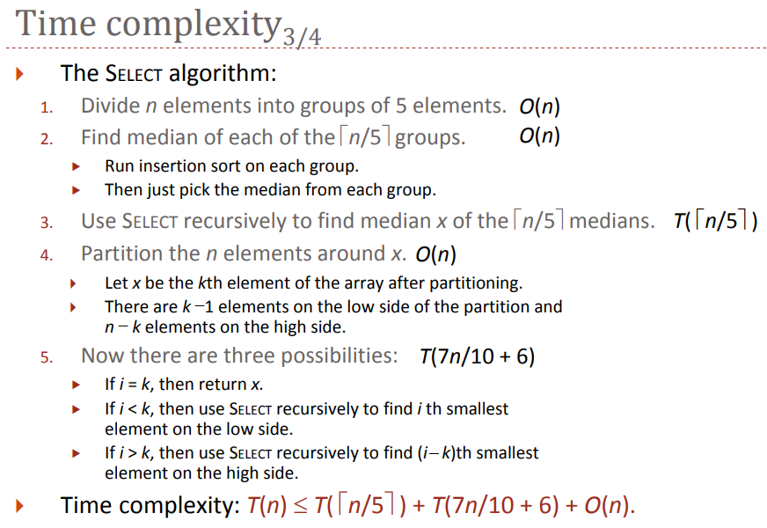

Slide 20
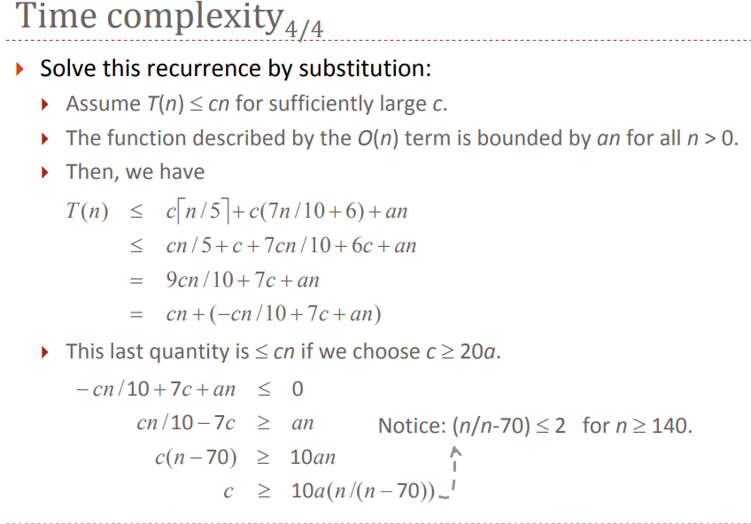

Slide 21
Summary
Finding the ith order statistic using sorting takes Ω(n lg n).
Not necessary to sort everything
Can leverage off of the PARTITION method from QUICKSORT
You can guarantee a good split by finding the median of medians

